Slide 1
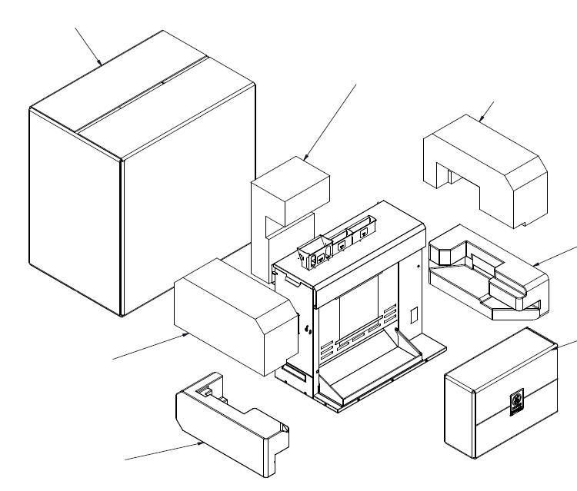
GST-3V 9210881
CARTON BOX 1250576
CENTER FOAM 1260414
TOP RIGHT FOAM 1260384
BOTTOM RIGHT FOAM 1260361
KIT BOX 0013410
TOP LEFT FOAM 1260383
BOTTOM LEFT FOAM 1260360
POLYBAG 5126025

Slide 2
KIT NUMBER 0013410 FOR UNIT 9210881
QUANTITY | ITEM NUMBER | DESCRIPTION
2 | 1000895 | LABEL, DO NOT DISCARD
1 | 1250573 | CARTON BOX
1 | 1012002 | OWNER’S MANUAL GST-3V INT’L
1 | 1050089 | IMPORTANT DO NOT DISCARD
1 | 5126009 | POLYBAG (9’’ X 12’’) 2MIL
Clean unit with spray cleaner (simple green) and towel.
Add kraft paper on the top and bottom on the inside of the kit box.
Add the following in bag (5126009) don't discard sheet (1050089) and manual (1012002)
When all pieces are inside the box (1250573) tape it shut.
Add do not discard label (1000895) to box.
Write the last 3 numbers of the unit in kit box with marker.

