Slide 1
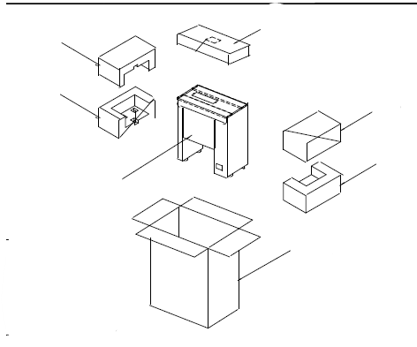
Kit Box 0012055
Top Foam
1260501
Bottom Foam
1260502
Top Foam
1260501
Bottom Foam
1260502
Polybag 5126003
Carton Box 1250307

Slide 2
Kit 0012055 for unit 9200628
QUANTITY | ITEM NUMBER | DESCRIPTION
1 | 1010729 | OWNER’S MANUAL VCT -20 INGLISH
1 | 1010729 CHS | OWNER’S MANUAL VCT -20 CHINESE
1 | 1010729 SPA | OWNER’S MANUAL VCT -20 SPANISH
1 | 1010729 ITALIAN | OWNER’S MANUAL VCT -20 ITALIAN
1 | 1010729 GER | OWNER’S MANUAL VCT -20 GERMAN
1 | 1010729 FRA | OWNER’S MANUAL VCT -20 FRANCH
1 | 1050089 | SHEET, IMPORTAN DO NOT DISCARD
1 | 7000249 | COVER GRILL PLATEN 3PACK
1 | 1250281 | CARTON BOX
1 | 5126009 | POLYBAG 9’X12’ 2MIL
1 | 1000895 | LABEL, DO NOT DISCARD
1 | 0503385 | CHUTE,BUN
Clean unit with spray cleaner (simple green) and towel
Add kraft paper on top and bottom on the inside of the kit box.
Add the fallowing in bag (5126009) two (2)platens (7000249) manual’s (1010729) sheet (1050089)
Wrap chute bun (0503385) in kraft paper
Added the chute bun and the bag with manuals inside the box, tape it shut.
Add DON’T DISCARD labe (1000895) to box,
Write the last 3 numbers of the unit in the box kit with marker.

