Slide 1
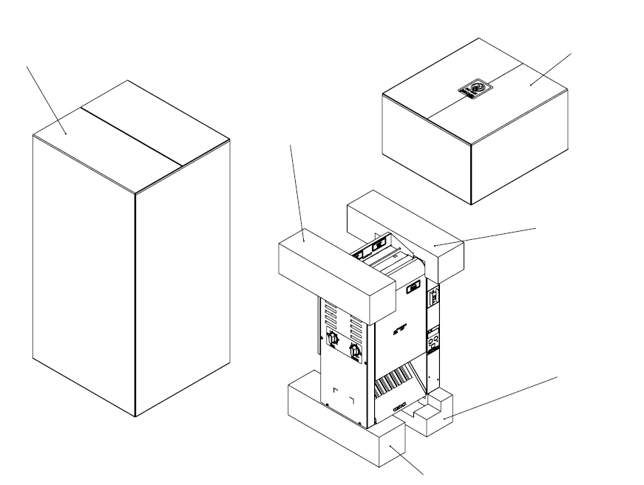
VCTM-2 UNIT 9210916
CARTON BOX 1250582
KIT BOX 0013500
TOP LEFT FOAM 1260456
TOP RIGHT FOAM 1260455
BOTTOM RIGHT FOAM 1260457
BOTTOM LEFT FOAM 1260458

Slide 2
KIT NUMBER 0013500 FOR UNIT 9210916
QUANTITY | ITEM NUMBER | DESCRIPTION
1 | 0510289 | BUN CHUTE WELDEMENT
1 | 0012989 | BUN FEEDER
1 | 1000895 | LABEL, DO NOT DISCARD
1 | 7001168 | SHEET PLATEN
1 | 1250581 | CARTON BOX
1 | 1011436 | OWNER’S MANUAL
1 | 1011436FRA | OWNER’S MANUAL
1 | 1011436GER | OWNER’S MANUAL
1 | 1011436SPA | OWNER’S MANUAL
1 | 1050089 | IMPORTANT DO NOT DISCARD
1 | 5126009 | POLYBAG, ZIP 9’’ X 12’’ X 2MIL
Add kraft paper on the top and bottom on the inside of the kit box.
Clean bun chute (0510289) and bun feeder (0012989)
Add important do not discard sheet (1050089) and manuals (1011436) (1011436FRA) (1011436GER) (1011436SPA) inside of polybag (5126009) also add Sheet platen (7001168) in the bag with manuals.
When all pieces are inside the box (1250581), tape it shut.
Add do not discard label (1000895) to box.
Write the last 3 numbers of the unit in the kit box with marker.

